Slide 1
Web Authoring
Project
http://www.yahmad.co.uk/

Slide 2
Project
Overview
In this unit you will create a fully functioning website including the following: Hyperlinks (Internal & External) Rollover Navigation Text & Images Tables CSS (Text and list styles) You can choose to create your website based on the following topics: Sports Movies/TV Cars Travel Computer games Fashion
http://www.yahmad.co.uk/

Slide 3
Lesson Overview
Unit Objectives
Understanding the positive design features of a website.
Understand how to create appropriate content (including rollover buttons) in suitable software.
Understand how to export and import files into suitable software.
Understand how to create and apply simple CSS text and list styles.
Understand how to create internal and external hyperlinks.
Outcomes |  | Time
Task 1 | Copy your chosen template folder.
Task 2 | Design: Website Proposal – Select an appropriate topic Design Site Map
Task 3 | Save up to 15 jpeg images into your images folder (inside the template folder)
Task 4 | Create appropriate tables within your design template.
http://www.yahmad.co.uk/

Slide 4
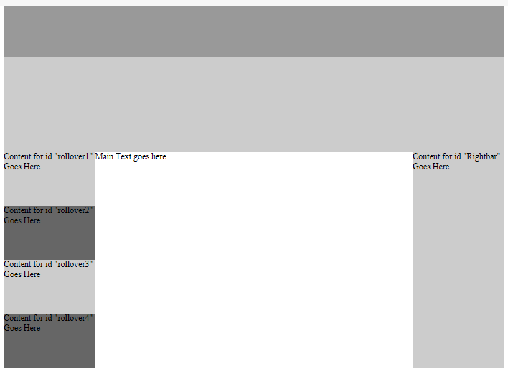
Task 1 – Template 1 – Copy your chosen Template Folder
Choose a Template (existing template)
height: 95px; width: 930px
height: 175px;width: 930px;
height: 100px;
width: 170px;
height: 400px;
width: 170px;
http://www.yahmad.co.uk/

Slide 5
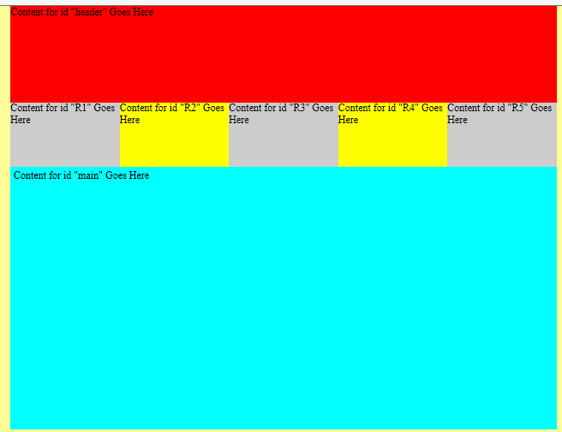
Task 1 – Template 2 – Copy the Template Folder
Template Size – You can change the Colours
height: 150px; width: 850px
height: 100px;
width: 170px;
height: 400px;
width: 840px;
http://www.yahmad.co.uk/

Slide 6
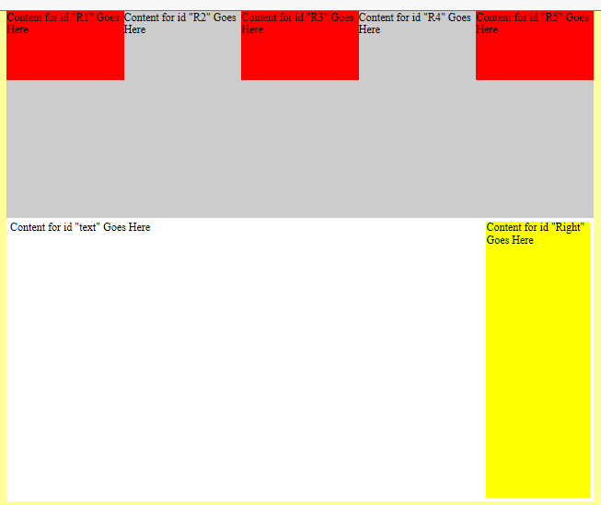
Task 1 – Template 3 – Copy the Template Folder
Template Size – You can change the Colours
height: 100px;
width: 170px;
height: 200px; width: 850px
height: 400px;
width: 680px;
height: 500px;
width: 150px;
http://www.yahmad.co.uk/

Slide 7
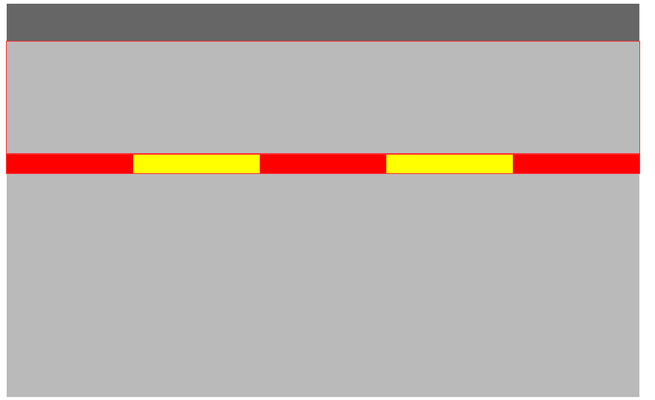
Task 1 – Template 4 – Copy the Template Folder
Template Size – You can change the Colours
height: 50px;
width: 850px;
height: 150px; width: 850px
height: 25px;
width: 170px;
height: 350px;
width: 850px;
http://www.yahmad.co.uk/

Slide 8
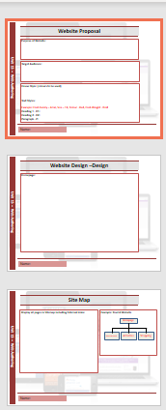
Task 2 - Design
Website Proposal
1. You need to complete the design documents which include the Website Proposal, Hand drawn Design and Sitemap documents. Purpose: What type of content will be provided on the website and what will be the reason for this? Target Audience: Who will the website be aimed at (Gender, Age, Genre etc.)? House style: What type of colours will be used on the website? CSS Text Styles: What type of text styles will you choose for your website – Consider fonts, colours, formatting etc. 2. You need to create a design for your homepage identifying rollover hyperlinks and animated content. 3. You need to create a site map showing the structure of your website.
http://www.yahmad.co.uk/

Slide 9
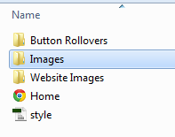
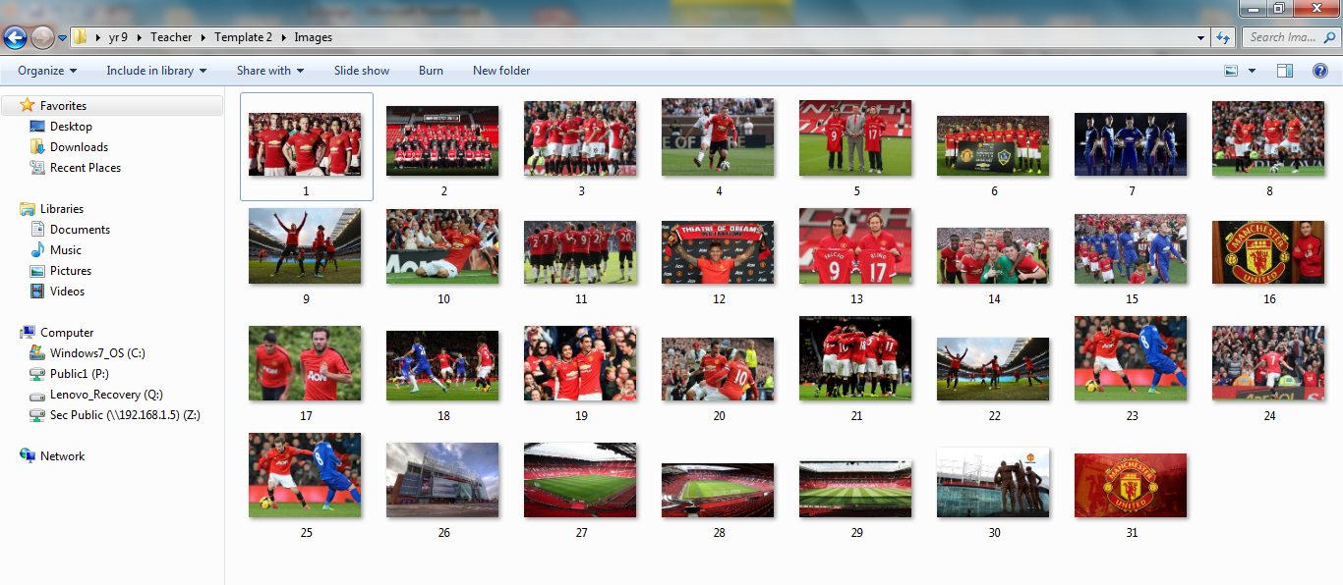
Task 3 – Save Images
Saving Images
1. You need to save up to 30 jpeg images based on your topic into the images folder within the template folder. You will use these images to create your website content. These pictures can also be used for the photo gallery page.
http://www.yahmad.co.uk/

Slide 10
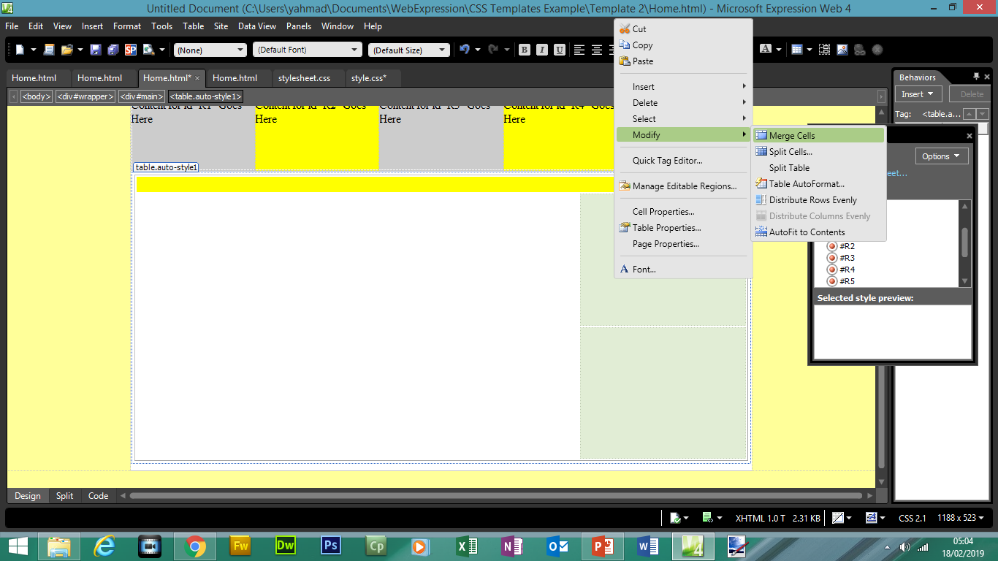
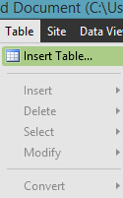
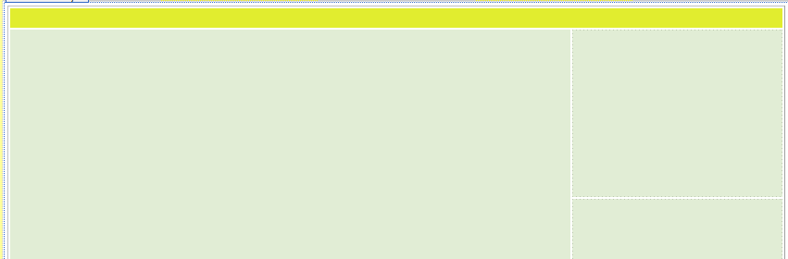
Task 4 – Create Table
Creating a Table
In order to achieve a higher level you need to create tables within the main content area of your page. You may need to refer to your designs. Click on Table >> Insert Table Select the number of rows and columns Select the width (pixels) Merge the relevant cells

Slide 11
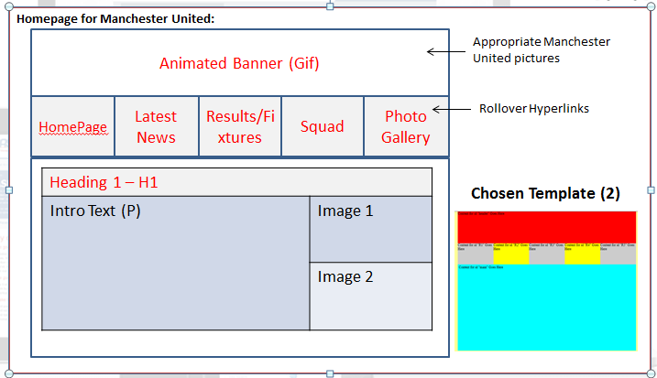
Example Design Based on Template 2
http://www.yahmad.co.uk/

